Slide 1
Hybrid Edge-Cloud System for Real-Time Industrial Asset Monitoring
ANKITHA CHOWDARY MADDIPATLA
W9628051

Slide 2
Introduction
Real-time monitoring enhances operational efficiency and reduces downtime in Industry.
A hybrid edge cloud system for real-time industrial asset monitoring
Combines cloud and edge computing to provide data access , real-time
Insights and process optimization
Edge systems for Real-time monitoring is hybrid edge-cloud system that combines low-latency local processing with scalable cloud-based analytics.
Improve Overall Equipment Effectiveness (OEE) metrics.

Slide 3
Problem statement
PROBLEMS:
Traditional cloud systems: High latency, cost, and network dependency
Edge systems: Lack scalability and advanced analytics
SOLUTION:
A hybrid edge-cloud system that combines low-latency local processing with scalable cloud-based analytics.
Better optimized and secured cloud management process

Slide 4
System Architecture
Edge Computing: Raspberry Pi, Mosquitto, Node-RED, InfluxDB, Grafana.
Cloud Integration: Azure IoT Hub, Stream Analytics, Data Lake, Power BI
Data Flow : Sensor data simulated using Python.
Processed locally on Raspberry Pi for low-latency visualization.
Transmitted to Azure IoT Hub for advanced analytics and visualization.

Slide 5
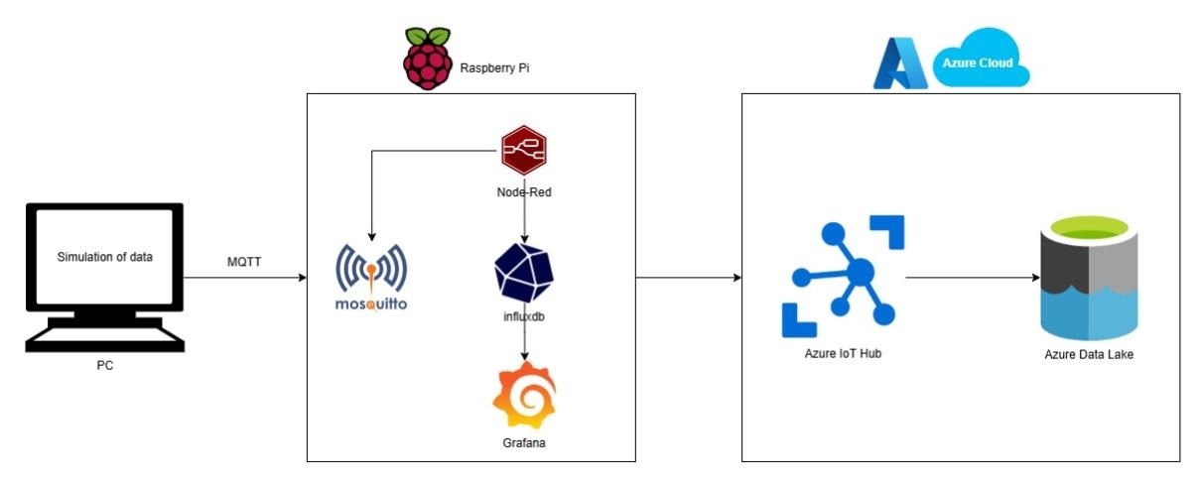

Slide 6
RESULTS AND KEY FINDINGS
Performance Metrics:
Latency: The system ensures swift data visualization both locally and on cloud, enabling real-time decision-making.
Scalability: It efficiently processes a significant volume of data without compromising performance, demonstrating its capability to handle large-scale industrial scenarios.
OEE Improvements:
Reduction in downtime.
Increase in production efficiency
Improvement in quality.
Challenges Addressed:
Network reliability: Retry mechanisms.
Data synchronization: Timestamp alignment.

Slide 7
CONCLUSION
Summary:
Hybrid systems balance the strengths of edge (low latency) and cloud (scalability and analytics).
The proposed solution is cost-efficient and impactful for real-time monitoring in IoT.
Future work:
Integration of real-world sensors.
Predictive maintenance models.
Advanced analytics using machine learning.

Slide 8
Thank you for your attention.
I would now be glad to address any questions you may have.

